Slide 1
Welcome
Presentation of Capstone 400C

Slide 2
Group Members
Honorable Supervisor
Md. Asif Imtiyaj Chowdhury, ID: 2019-3-60-115,
Mridul Ranjan Karmakar, ID: 2018-3-60-021,
Shafika Sikander, ID: 2019-3-60-057,
Prianka Sarker, ID: 2019-3-60-076
Department of Computer Science Engineering East West University
Dr. Md. Hasanul Ferdaus
Assistant Professor
Department of Computer Science Engineering East West University

Slide 3
Title: Environment Friendly Semi-automated Robotic Lake Surface Cleaner For Enhancing Aquatic Life: A Bangladesh’s Perspective

Slide 4
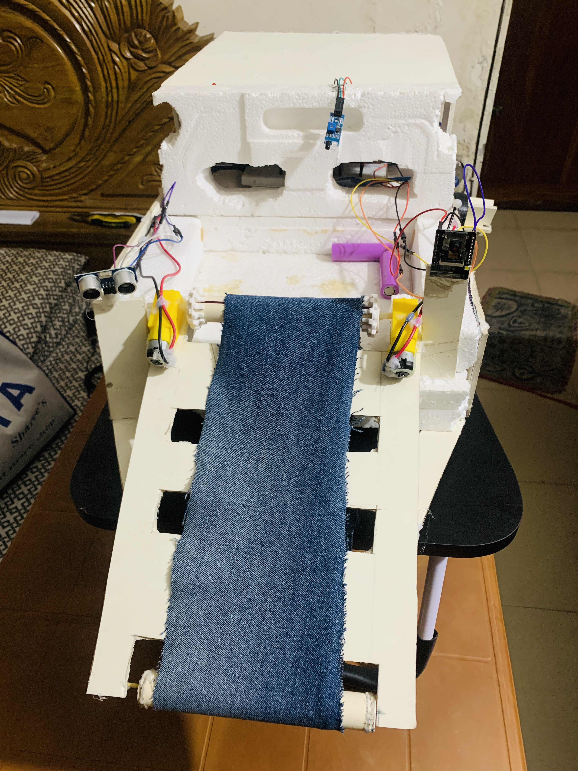
Introduction
A lake cleaning robot is a remotely operated vehicle specifically designed to identify, collect, and remove plastic waste, particularly polyethylene from lakes
The Lake Cleaner Robot represents a significant advancement in the field of environmental robotics, providing an effective and sustainable solution to combat water pollution
The cleaner operates using a semi-automated system that combines the power of robotics with advanced sensors and software to detect and remove floating waste from the water
The robot is a state-of-the-art unmanned watercraft equipped with cutting-edge technology and specialized cleaning mechanisms
Figure: Floating Plastic Bottles

Slide 5
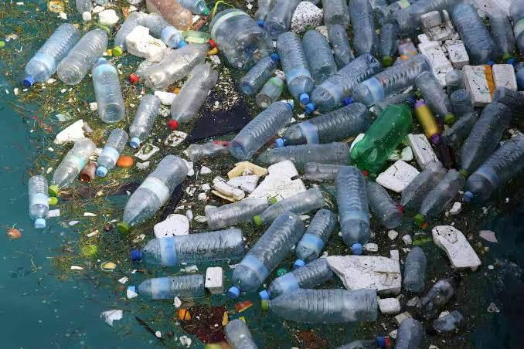
The State of Aquatic Life in Bangladesh
Bangladesh is home to a diverse range of aquatic life, including over 260 species of freshwater fish
However, this rich biodiversity is under threat due to pollution and habitat destruction
The main challenges facing aquatic life in Bangladesh include industrial pollution, agricultural runoff, and overfishing
According to a recent study, over 80% of the country's rivers are polluted, with high levels of toxic chemicals and heavy metals
Figure: Floating Plastic Bottles

Slide 6
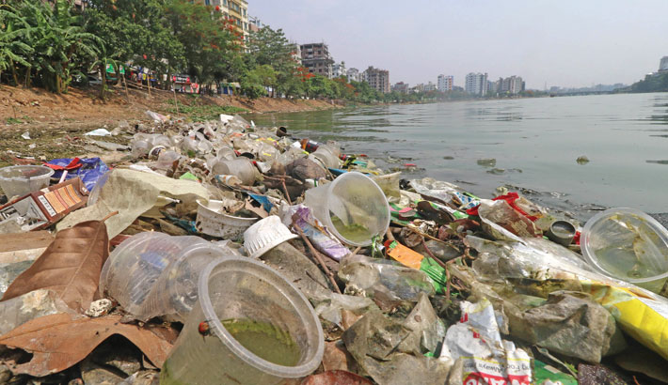
Background
Water is a precious natural resource that is essential for all life on Earth and despite having an abundance of water, water contamination is a major problem in many regions
The majority of Bangladesh now has access to clean drinking water from technically sophisticated sources of water in 98 percent of cases [1]
Over the past few years, water contamination in bodies of water has significantly increased
In contrast to impairments brought on by work-related accidents, health implications also include musculoskeletal, digestive, and vector-borne infections
Figure : Floating plastics and polythene’s in lake

Slide 7

The Need for Environment-friendly Solutions
The challenges facing aquatic life in Bangladesh are complex and multifaceted. Pollution, climate change, and overfishing are just a few of the factors contributing to the decline of fish populations and the degradation of water quality
One example of an environment-friendly solution is the semi-automated robotic lake surface cleaner. By using advanced technology to remove debris and pollutants from the surface of lakes and rivers, this cleaner can help restore aquatic ecosystems and promote the growth of fish populations

Slide 8
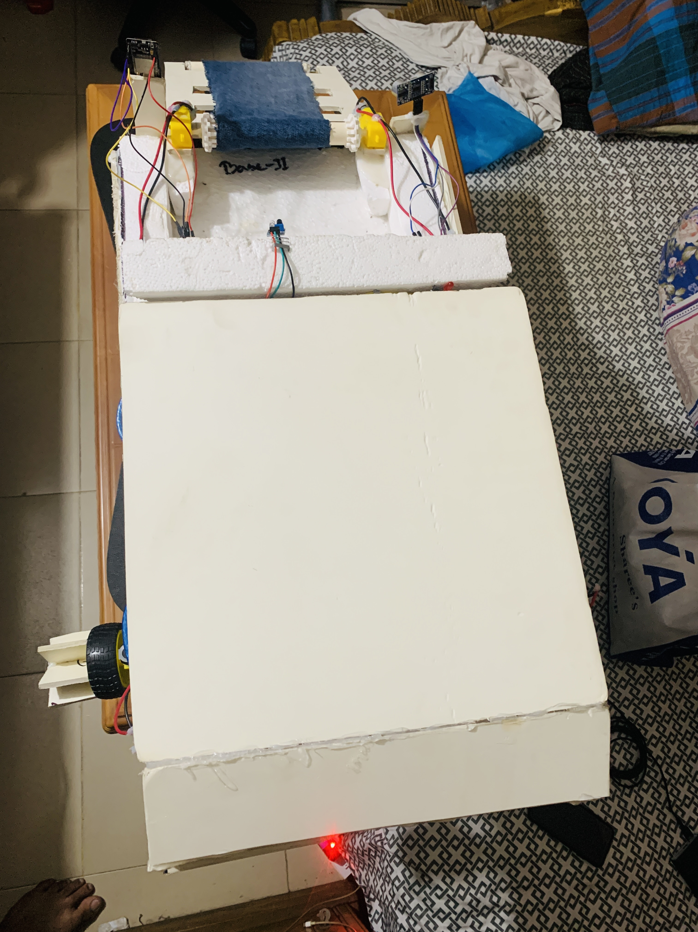
Overview Of Our Cleaning Robot
Figure: Front View
Figure: Top View

Slide 9
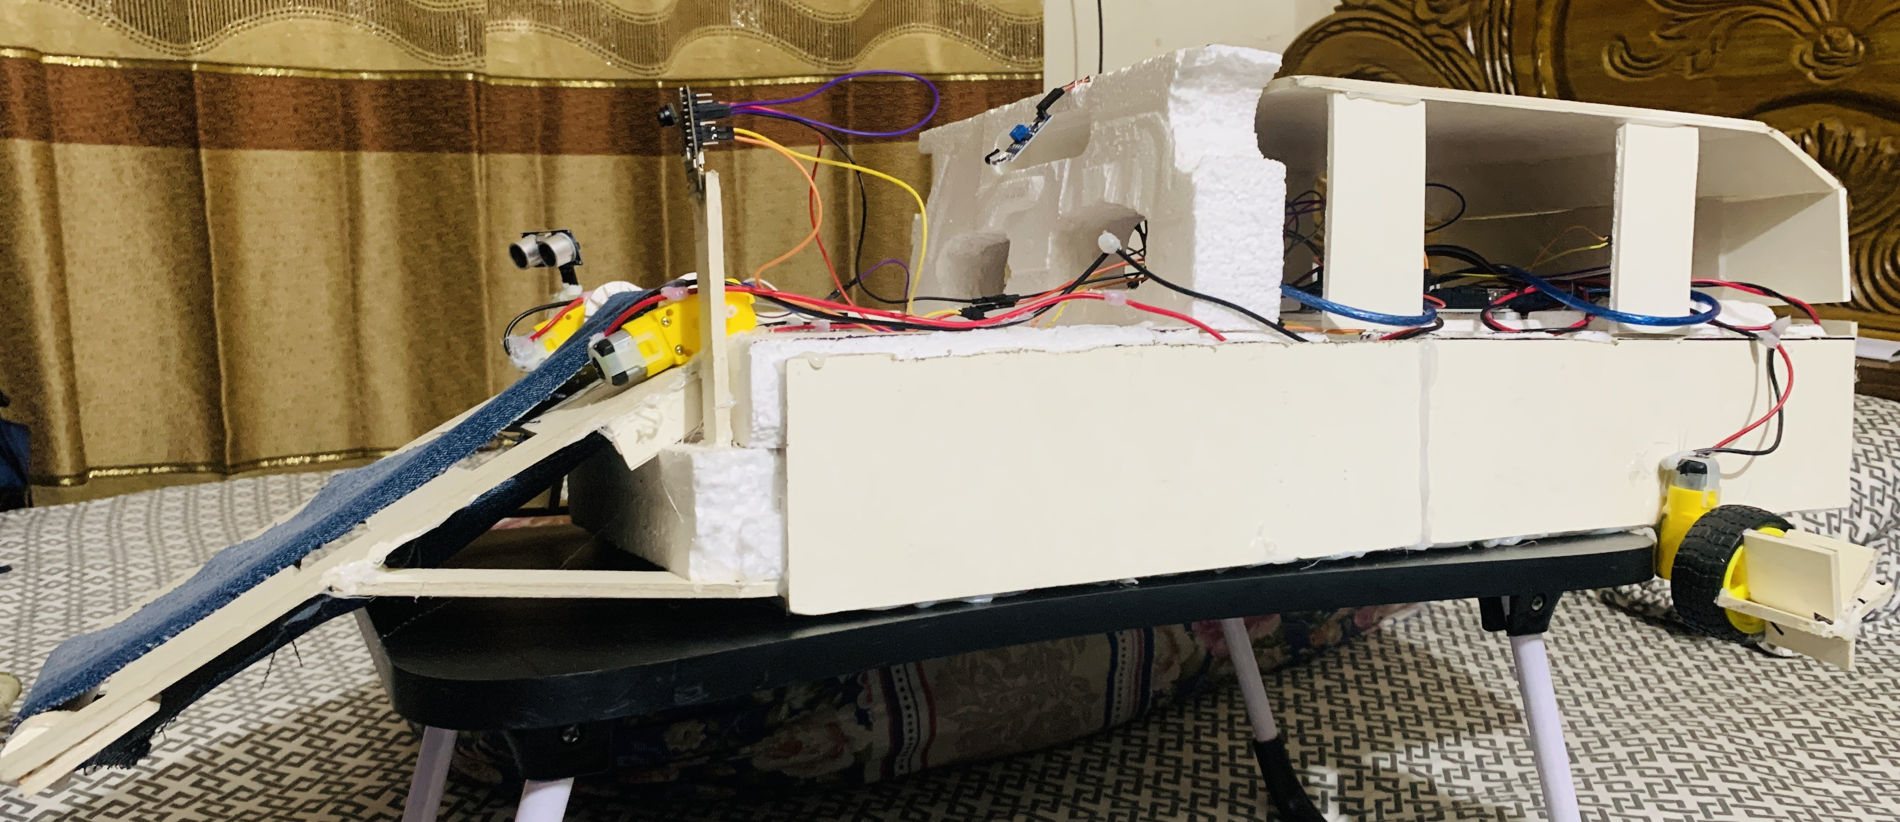
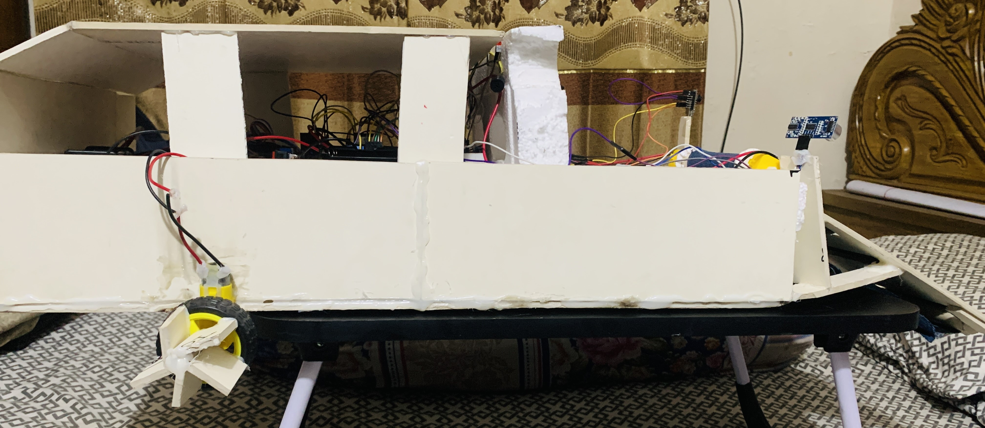
Overview Of Our Cleaning Robot
Figure: Side View
Figure: Side View

Slide 10
Benefits of the Robot Cleaner
The semi-automated lake surface cleaning robot offers numerous benefits for enhancing aquatic life in Bangladesh. First and foremost, it has a significant positive environmental impact by removing harmful waste from water
This not only improves the health of the aquatic ecosystem but also benefits the surrounding community by providing clean water for consumption and recreation in wild life
It helps to remove plastic objects from water bodies, improving water quality and preserving the ecosystem

Slide 11
Related Work
For the purpose of collecting trash in bodies of water, an autonomous robot was created.
The AT-MEGA 16 microcontroller was used to create a robot with DC and servo motors as well as sensors. All of the modules were tested to determine the viability of the suggested robot [6]
With the help of an Arduino Mega microcontroller connected to sensors and actuators, a complete robotic system was created. The robot moves around on its chassis, wheels, motors, and grippers. Infrared and ultrasonic sensors are used for object detection and sensing [6]
Leveraging image processing, an automatic garbage segregation robot was created to sort waste into biodegradable and degradable categories before depositing the waste into the appropriate container [7]

Slide 12
Problem Statement
Lake pollution in Bangladesh is a serious problem that has far-reaching consequences for aquatic life
The country's rapid industrialization and urbanization have led to increased levels of pollutants in water bodies, including lakes
Most rivers in Bangladesh that flow through major cities have become polluted due to a variety of anthropogenic pollution, with plastic being one of the most prevalent issues[21]
The main cause of this is poor waste management in the city's water bodies. As a result, it has been established that microplastic pollution in freshwater systems is a global issue[21]

Slide 13
Research Questions
What is the motive to build an IoT device for cleaning floating waste from lakes?
Why it is important to develop a device that can collect floating waste from a lake without any human interactions?
How can the model identify the floating wastes using machine learning model?
Will the designed device perform well in the lakes of Dhaka city?

Slide 14
Aim
The aim of this project is to study the current state of floating wastes in water bodies and its problems, research on potential solution approaches, design and construct a IoT-based semi-automated lake surface cleaning robot as a solution for a clean aquatic life and evaluate the performance of the device.
Objectives
● To identify and selection of the removal floating garbage in a lake
● To construct the hardware components of the IoT device
● To develop the software modules of the IoT device
● To collect the identified floating garbage
● To analyze the device performance for the future improvements

Slide 15
Focus
Our focus is to operate in Dhanmondi lake/Gulshan Lake of Dhaka Bangladesh
We want to evaluate the performance of our device so that in near future we can improve/upgrade the device and it can be used in every lake of Bangladesh to clean the garbage for enhancing aquatic life
During the study, we are focusing on collecting floating waste from city lakes using semi-automatic IoT device

Slide 16
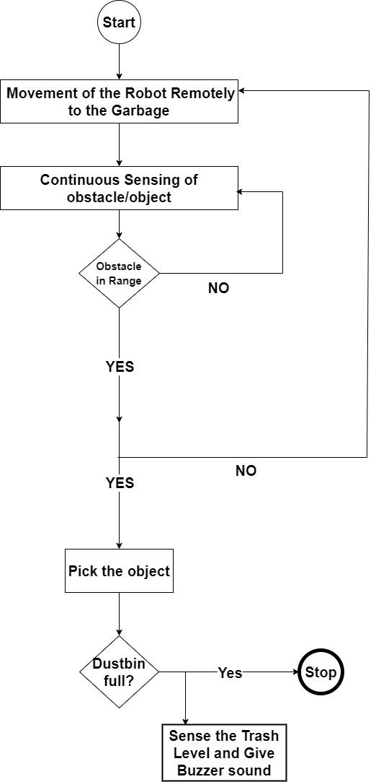
Methodology
Figure: Workflow Diagram

Slide 17
Materials
Hardware Components:
2 Arduino Uno R3
1 Breadboard
1 Ultrasonic Sensors
4 DC geared motors (180rpm dual shaft, 6V)
1 IR sensor
1 ESP-32 Camera Module
1 NodeMCU-ESP8266
2 Motor Driver (L298N Driver)
10 Power Supply Battery (Model:18650, 7800 mAh, 3.7V each)
1 Buzzer
2-Power on/off switch
2 Propellers
1 Conveyor Belt
100 Jumper wires
3 ft copper wires
1 Trash bin
PVC board (5mm each)
Cocksheets
1 Barrell Jack

Slide 18
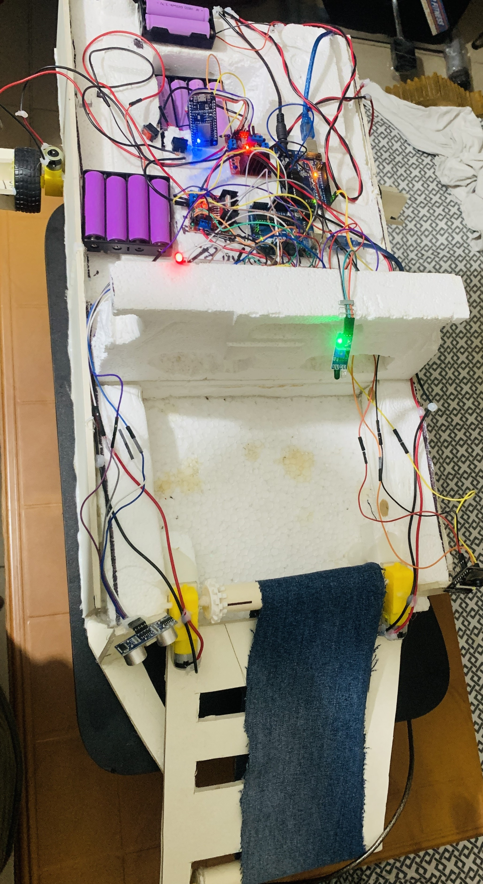
Design and Implementation
The design is ensured the robot's stability, buoyancy, and resistance to environmental factors such as waves, wind
Depending on the size and scope of the lake, the robot is powered by batteries
Efficient energy management systems are crucial to optimize the robot's operational time and reduce the need for frequent recharging or maintenance
Mapping technology can help the robot create a map of the lake, enabling it to systematically clean the entire area
The cleaning mechanisms include nets, suction systems, depending on the specific cleaning requirements
Figure: Design of lake cleaning robot

Slide 19
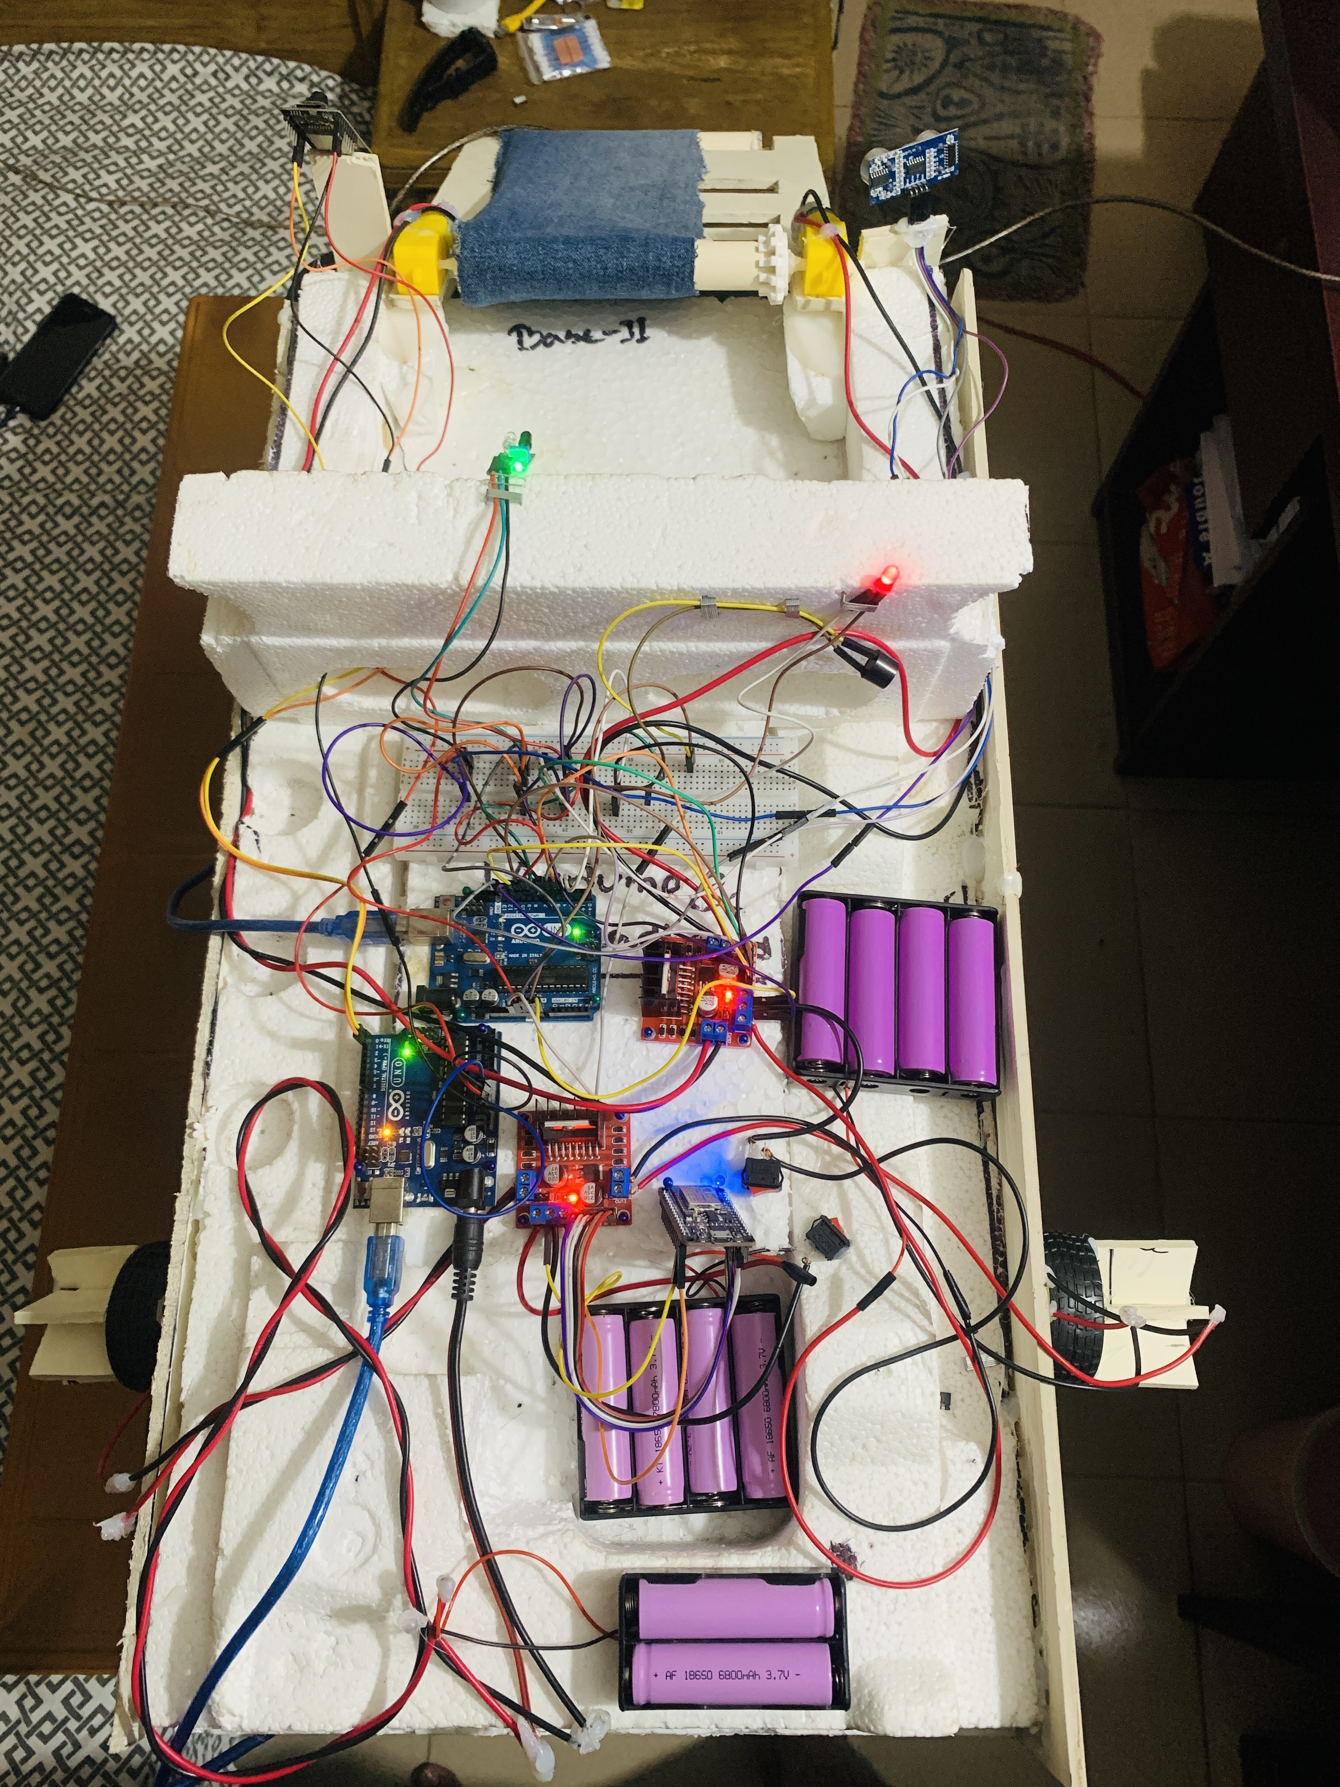
Design and Implementation
Table 1. Device Specification
Design parameters | Value
Dimensions | Length: 3 ft Width: 1.5 ft
Net weight (only robot) | 3-4 kg
Maximum weight (with load) | 4-5 kg
Average battery while cleaning | Minimum 30 minutes
Propeller type | Three blades
Control system | Manual (remote control)
Dive motos | Motor Driver L298N
Waste Collection system | Wide net
Figure: Design of lake cleaning robot

Slide 20
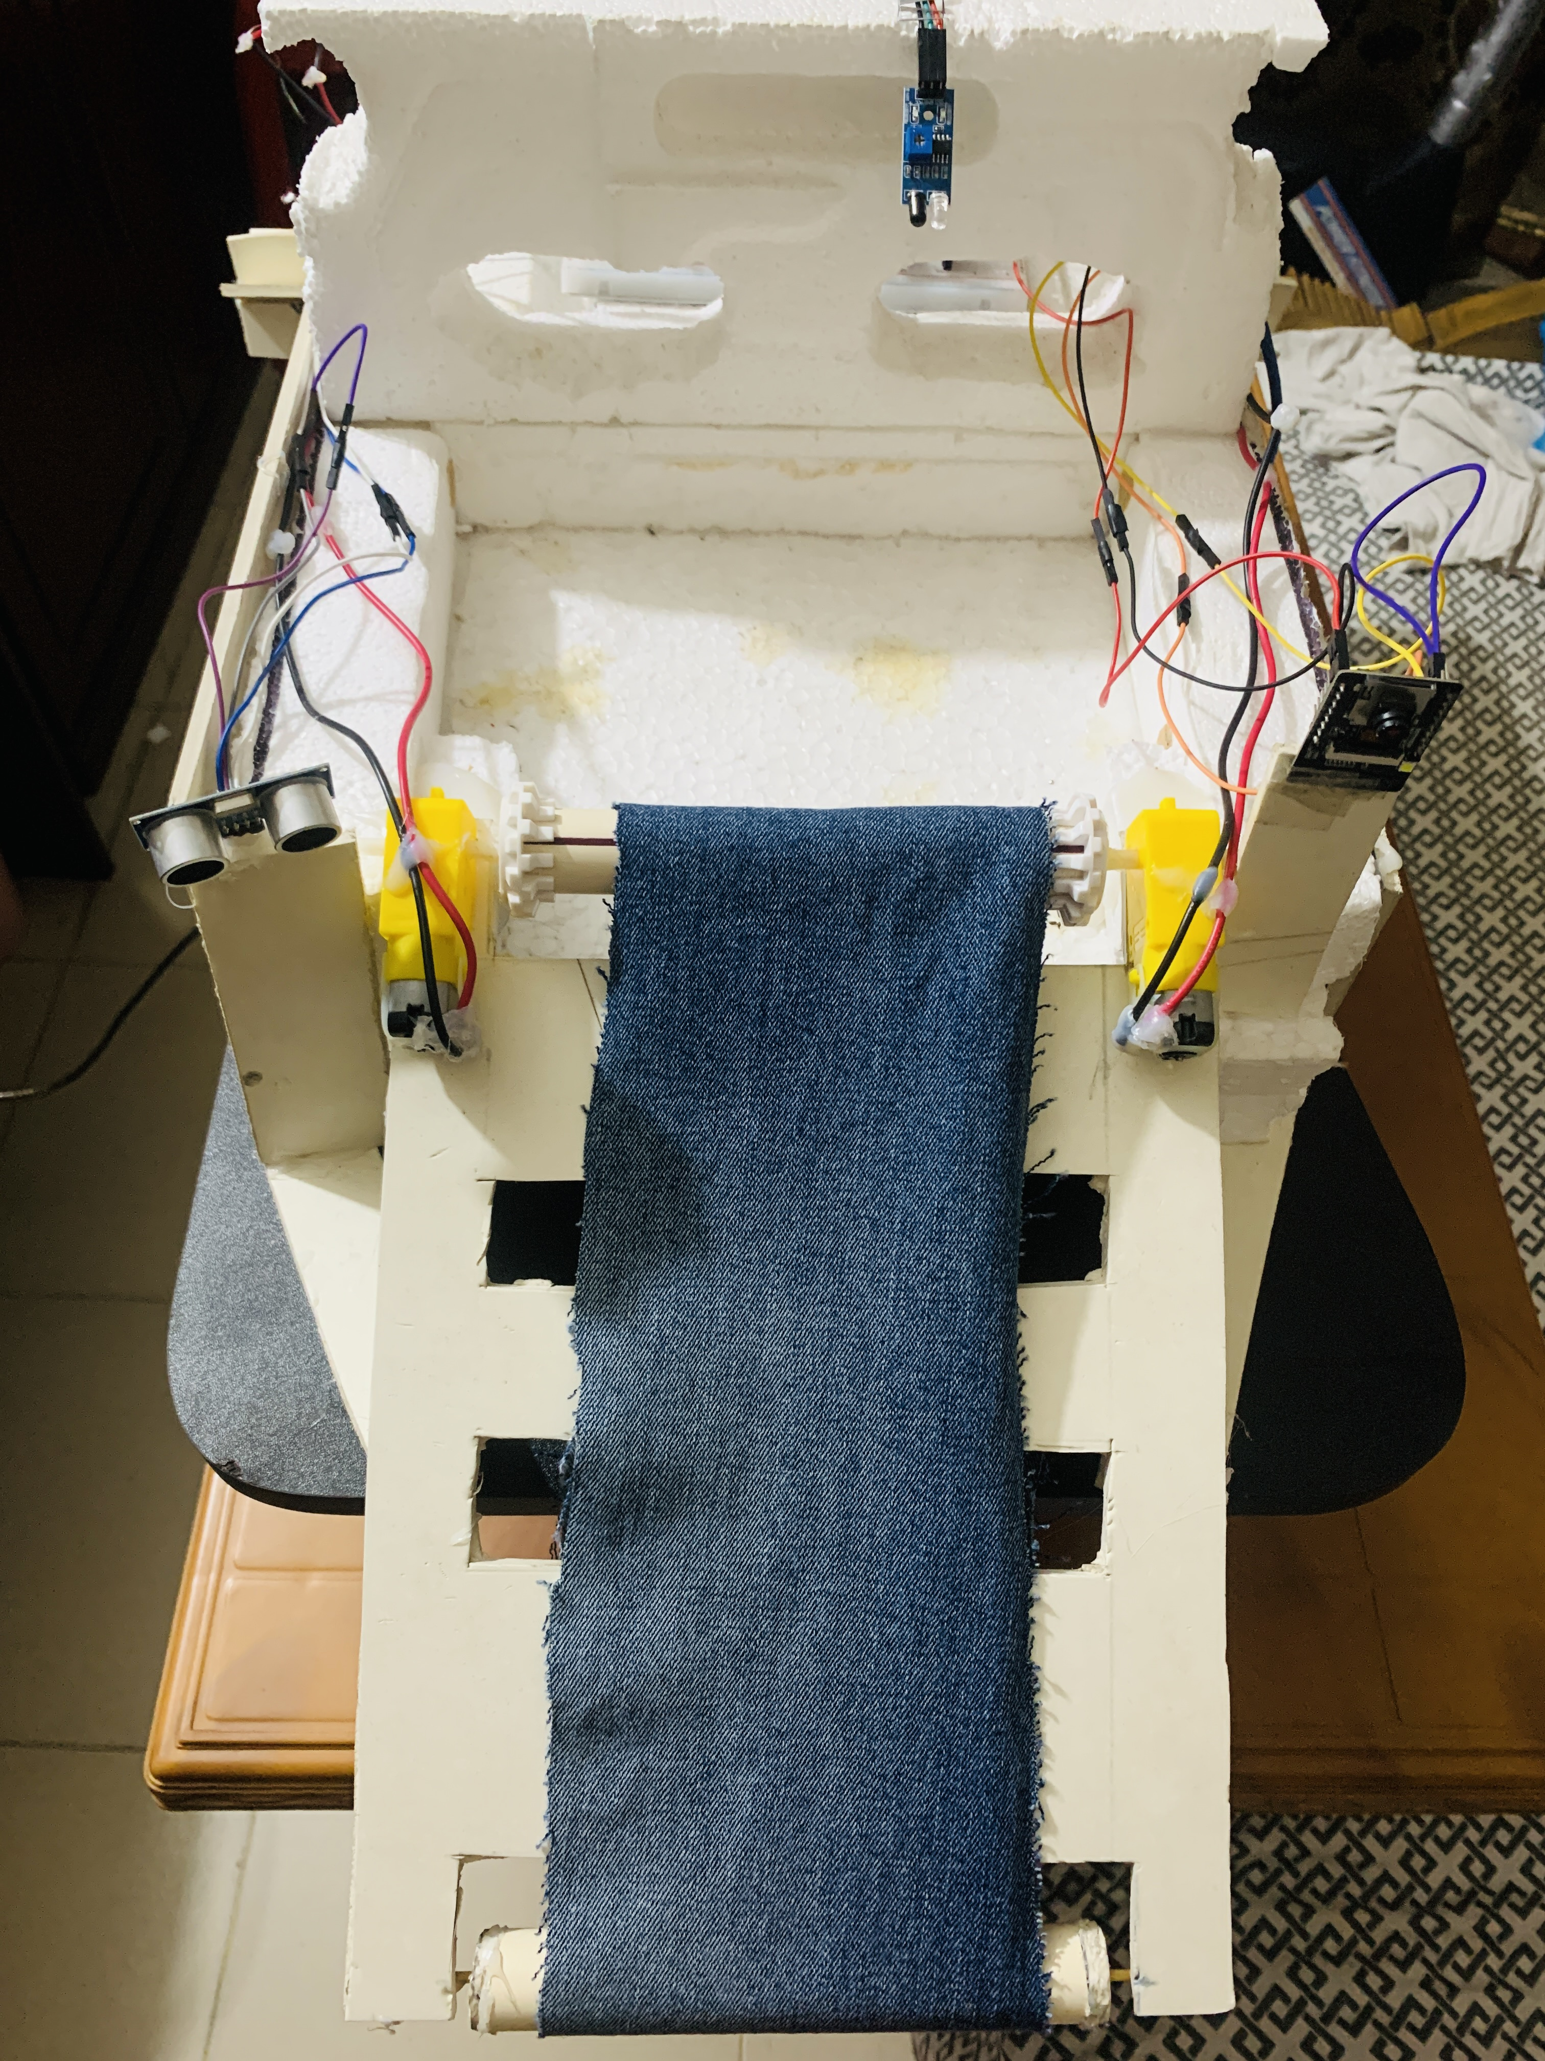
Semi-automated Waste Collection System Using Ultrasonic sensor, DC motor, Motor Driver
The Ultrasonic sensors, in contrary to photoelectric sensors, can distinguish an object without being altered by its color.
It is a device that detects things and measures distances using sound waves.
Ultrasonic sensors used in Arduino determine distances by producing high-frequency sound waves and detecting their reflections.
The ultrasonic sensor receives a trigger signal from the Arduino. This signal is typically a brief pulse of high voltage (about 10 microseconds).When the ultrasonic sensor gets the trigger signal, it produces a brief ultrasonic pulse.
Knowing the speed of sound in air the Arduino can calculate the distance to the object using the formula: Distance = (Speed of Sound × Time) / 2.

Slide 21
W-Fi Controlled Seamless Navigation
NodeMCU is a microcontroller development board with Wi-Fi capability.. It uses ESP8266 microcontroller chip
NodeMCU generates Wi-Fi signal and connect the Wi-Fi in any android device
Table: Technical Specification of L298N Driver
Motor output voltage | 5V-35V
Motor output voltage (Recommended) | 7V – 12V
Logic input voltage | 5V – 7V
Continuous current per channel | 2A
Max Power Dissipation | 25W
Figure: The assembled circuit of L298N motor driver, DC motors and Arduino Uno R3 with 14.3V power supply

Slide 22
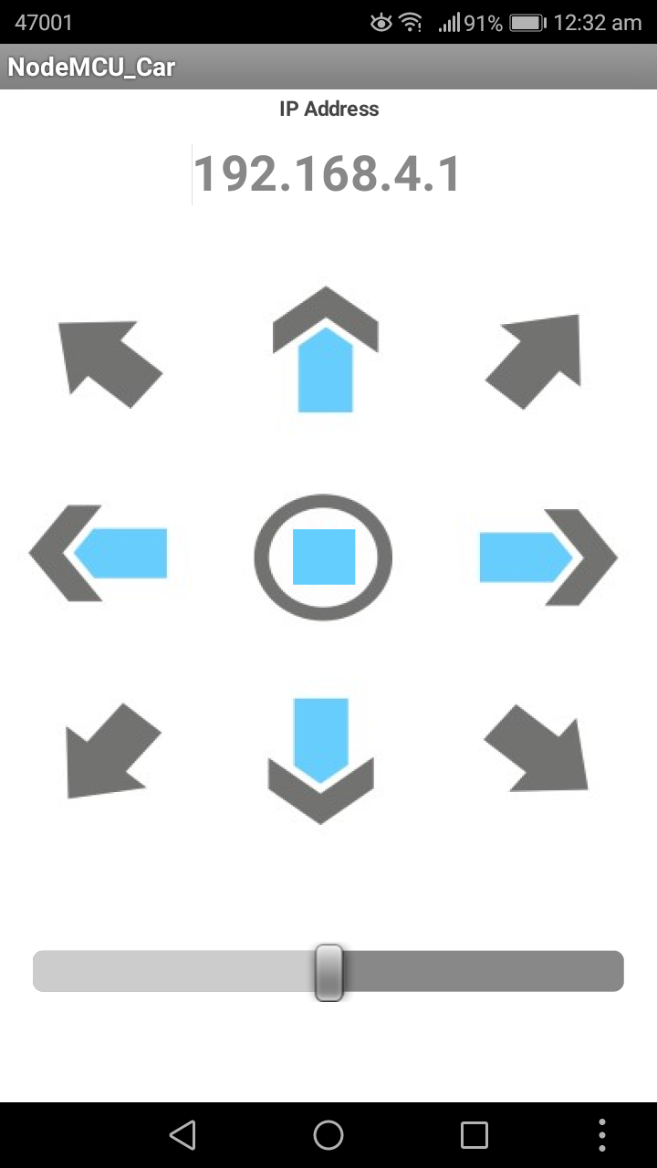
W-Fi Controlled Seamless Navigation
For navigation, we are using a mobile application
Our Device can move in Forward, backward, left and right direction
We can adjust the speed of motor rotation
Figure: Android app for navigation

Slide 23
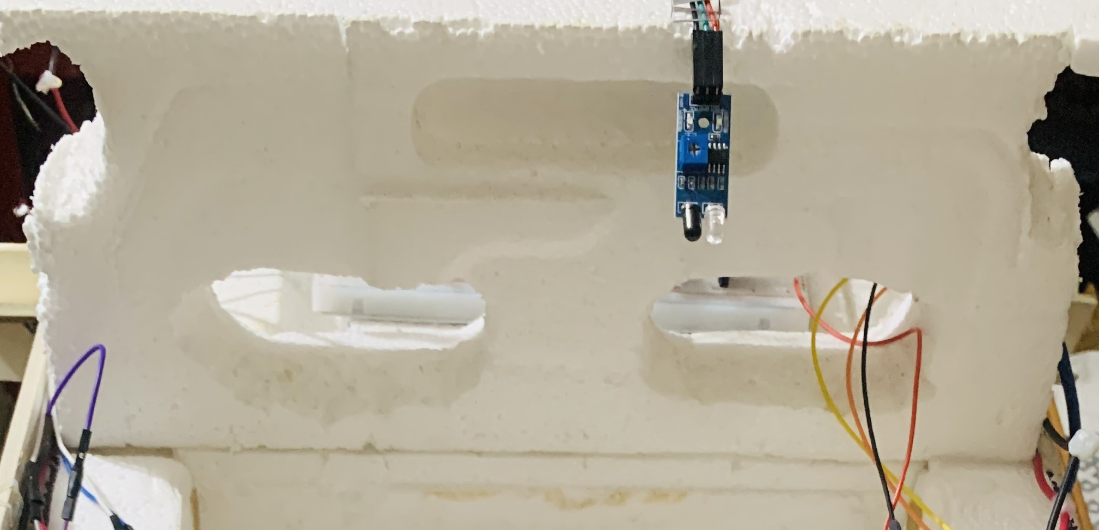
IR Sensor For Trash Level Detection
The IR sensor module contains an infrared detector (usually a photodiode) that is sensitive to infrared radiation.
The output of the IR sensor module can be either analog or digital, depending on the specific sensor module.
The Arduino can read the sensor's output value using a digital pin set as an input.
Figure: IR Sensor for trash level detection

Slide 24
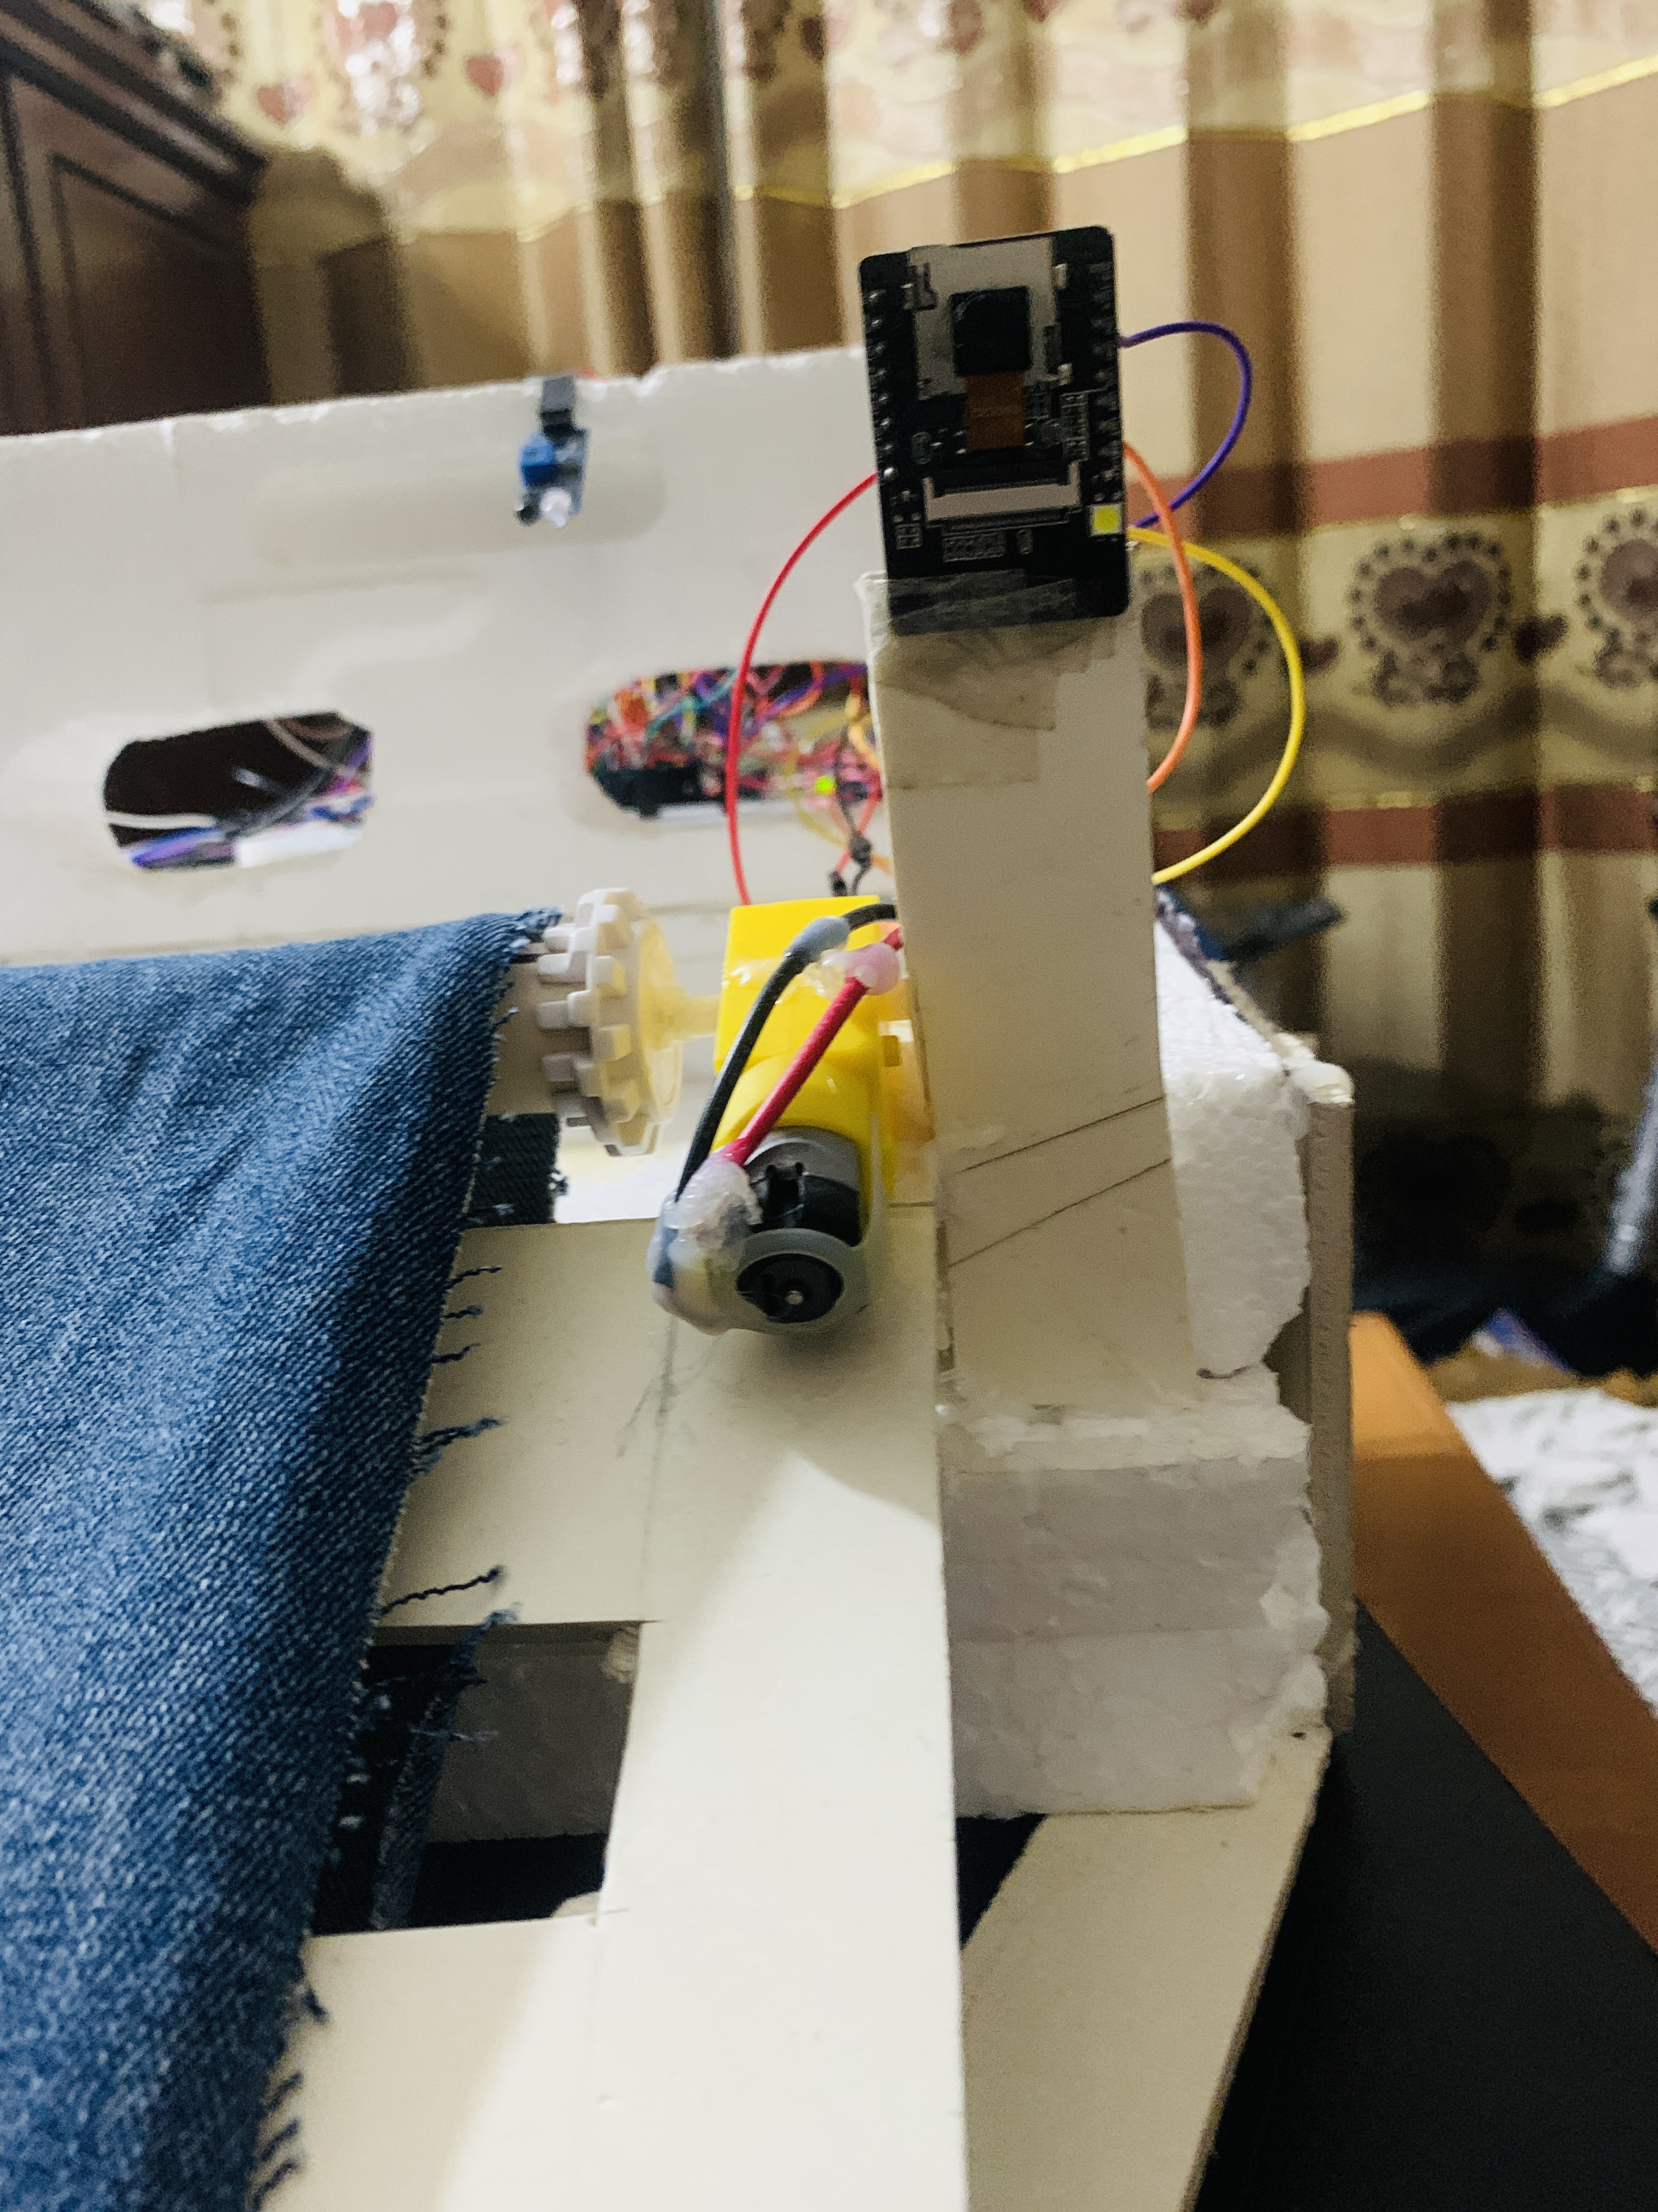
Camera Integration With ESP-32
ESP32 is a series of low-cost, low-power system on a chip microcontrollers with integrated Wi-Fi and dual-mode Bluetooth.
Stream real-time video footage using ESP-32 camera module
View live video in any browser with the generated public IP address
Keep an eye on your surroundings through the ESP-32 camera
Figure: ESP32 for Real Time Footage

Slide 25
Future Plan
The aim is to enhance the efficiency of trash cleaning robot and contribute to the preservation of our lakes
Getting Real-time video footage using ESP-32
Image processing and object detection using ESP-32 camera module with YOLO v7
Measuring battery consumption level during operating time and idle time

Slide 26
Results (upon manual testing)
The robot will mostly be designed to make a very helpful system to remove water impurities like plastics, floating waste, and polyethene which is floating on the surface of a lake
Most of the water floating bodies will be cleaned by using the robot and worker mortality will be decreased.

Slide 27
Descriptive Video of Manual Testing

Slide 28
References
[1] “Bangladesh: Access to Clean Water Will Reduce Poverty Faster.” https://www.worldbank.org/en/news/press-release/2018/10/11/bangladesh-access-to-clean-water-will-reduce-poverty-faster (accessed Feb. 20, 2023).
[2] J. R. Jambeck et al., “Plastic waste inputs from land into the ocean,” Science (1979), vol. 347, no. 6223, pp. 768–771, Feb. 2015, doi: 10.1126/SCIENCE.1260352/SUPPL_FILE/JAMBECK.SM.PDF.
[3] L. C. M. Lebreton, J. Van Der Zwet, J. W. Damsteeg, B. Slat, A. Andrady, and J. Reisser, “River plastic emissions to the world’s oceans,” Nat Commun, vol. 8, Jun. 2017, doi: 10.1038/ncomms15611.
[4] “Water In Crisis - Spotlight Banglasdesh.” https://thewaterproject.org/water-crisis/water-in-crisis-bangladesh (accessed Mar. 12, 2023).
[5] M. J. Uddin and Y. K. Jeong, “Urban river pollution in Bangladesh during last 40 years: potential public health and ecological risk, present policy, and future prospects toward smart water management,” Heliyon, vol. 7, no. 2. Elsevier Ltd, Feb. 01, 2021. doi: 10.1016/j.heliyon.2021.e06107.
[6] “Bangladesh Clean Water Access 2000-2023 | MacroTrends.” https://www.macrotrends.net/countries/BGD/bangladesh/clean-water-access-statistics (accessed Mar. 12, 2023).

Slide 29
References
[7] “Pollution: Causes, Effects and Control - Google Books.” https://books.google.com.bd/books?hl=en&lr=&id=1kFbRYQUqcAC&oi=fnd&pg=PA1&ots=NzpbFL8iof&sig=9Dn0zRlRTq2UfqkVZf9oAzJY8xs&redir_esc=y#v=onepage&q&f=false (accessed Mar. 14, 2023).
[8] “Water Pollution Of Most Of The Water Sources In Bangladesh - FAIR.” https://fairbd.net/water-pollution-of-most-of-the-water-sources-in-bangladesh/ (accessed Mar. 14, 2023).
[9] “Javier: Water Pollution from Agriculture: a Global... - Google Scholar.” https://scholar.google.com/scholar_lookup?title=Water%20Pollution%20from%20Agriculture%3A%20a%20Global%20Review.%20Rome%2C%20Colombo%3A%20the%20Food%20and%20Agriculture%20Organization%20of%20the%20United%20Nations%2C%20International%20Water%20Management%20Institute%20on%20Behalf%20of&author=M.-S.%20Javier&publication_year=2017 (accessed Mar. 14, 2023).
[10] “A Snapshot of the World’s Water Quality: Towards a global assessment.” [Online]. Available: www.unep.org
[11] S. A. kumar* and S. Sasikala, “Effective Aquatic Waste Removal through Lake Cleaning Robot for Smart city Environment,” International Journal of Innovative Technology and Exploring Engineering, vol. 9, no. 4, pp. 2831–2835, Feb. 2020, doi: 10.35940/IJITEE.C8905.029420.

Slide 30
References
[12] S. Journal and U. Journal, “International Journal of Innovative Technology and Exploring Engineering (IJITEE),” 2020, doi: 10.35940/ijitee.C8905.029420..
[13] J. Zhu, Y. Yang, and Y. Cheng, “SMURF: A Fully Autonomous Water Surface Cleaning Robot with A Novel Coverage Path Planning Method,” J Mar Sci Eng, vol. 10, no. 11, Nov. 2022, doi: 10.3390/JMSE10111620.
[14] R. Kamath, D. D. Salvankar, D. D. Salvankar, and A. D. Shetty, “WATER GARBAGE COLLECTOR USING ANDROID”, Accessed: Mar. 15, 2023. [Online]. Available: www.irjmets.com
[15] A. O. Djekoune, K. Achour, and R. Toum, “A sensor based navigation algorithm for a mobile robot using the DVFF approach,” Int J Adv Robot Syst, vol. 6, no. 2, pp. 97–108, 2009, doi: 10.5772/6797.
[16] H. Cui, Y. Li, and J. Liu, “An Obstacle Detection Algorithm Based on Ultrasonic Sensors for Autonomous Land Vehicle,” 2016, doi: 10.2991/MCAE-16.2016.35.

Slide 31
References
[16] H. Cui, Y. Li, and J. Liu, “An Obstacle Detection Algorithm Based on Ultrasonic Sensors for Autonomous Land Vehicle,” 2016, doi: 10.2991/MCAE-16.2016.35.
[17] N. A. S. Kamarudin, I. N. A. M. Nordin, D. Misman, N. Khamis, M. R. M. Razif, and F. H. M. Noh, “Development of Water Surface Mobile Garbage Collector Robot,” Alinteri Journal of Agriculture Sciences, vol. 36, no. 1, pp. 534–540, Jun. 2021, doi: 10.47059/ALINTERI/V36I1/AJAS21076.
[18] O. Nurlansa, D. Anisa Istiqomah, and M. Astu Sanggha Pawitra, “AGATOR (Automatic Garbage Collector) as Automatic Garbage Collector Robot Model,” International Journal of Future Computer and Communication, vol. 3, no. 5, pp. 367–371, Oct. 2014, doi: 10.7763/ijfcc.2014.v3.329.
[19] M. M. Idhris, M. E. parthi, C. M. Kumar, N. N. vathy, K. S. waran, and S. A. kumar, “Design and fabrication of remote controlled sewage cleaning machine,” International Journal of Engineering Trends and Technology, vol. 45, no. 2, pp. 63–65, Mar. 2017, doi: 10.14445/22315381/IJETT-V45P214.

Slide 32
References
[20] N. C. Daniels, “Drainage System Cleaner A Solution to Environmental Hazards,” 2014. [Online]. Available: www.irjes.com
[21] G. W. Chowdhury et al., “Plastic pollution in aquatic systems in Bangladesh: A review of current knowledge,” Science of the Total Environment, vol. 761, Mar. 2021, doi: 10.1016/J.SCITOTENV.2020.143285.
[22] M. S. Bhuyan, “Effects of Microplastics on Fish and in Human Health,” Front Environ Sci, vol. 10, p. 250, Mar. 2022, doi: 10.3389/FENVS.2022.827289/BIBTEX.
[23] “‘We will have the rivers cleaned by March 2023’: NRCC Chairman | River Pollution in Bangladesh.” https://www.tbsnews.net/features/panorama/repeat-offenders-who-pollute-rivers-should-be-jailed-nrcc-chairman-520134 (accessed Mar. 14, 2023).
[24] “Technical Explanation for Ultrasonic Sensors”.Zhang, X., Wu, X., &amp; Zhu, J. (2020). Deep Multispectral Fusion Object Detection in Marine Environment. IEEE

Slide 33
References
[25] Zhang, X., Wu, X., &amp; Zhu, J. (2020). Deep Multispectral Fusion Object Detection in Marine Environment. IEEE Access, 8, 5319-5328.
[26] He, Y., Lu, J., &amp; Wu, J. (2019). Deep Watershed Transform with Discriminative Network for Underwater Object Detection. IEEE International Conference on Image Processing (ICIP), 3025-3029.
[27] Bewley, A., Ge, Z., Ott, L., Ramos, F., &amp; Upcroft, B.(2016). Simple Online and Realtime Tracking with a Deep Association Metric. IEEE International Conference
on Image Processing (ICIP), 3647-3651.
[28] Arulampalam, S., Maskell, S., Gordon, N., &amp; Clapp, T. (2002). A Tutorial on Particle Filters for Online Nonlinear/Non-Gaussian Bayesian Tracking. IEEE Transactions on Signal Processing, 50(2), 174-188.
[29] Li, X., Zhang, X., Hu, Q., &amp; Zhang, L. (2021). Garbage Classification by Deep Learning for Automatic Ocean Garbage Collection. IEEE Access, 9, 45019-
45029.

Slide 34
References
[30] Redmon, J., Divvala, S., Girshick, R., &amp; Farhadi, A. (2016). You Only Look Once: Unified, Real-Time Object Detection. IEEE Conference on Computer Vision and Pattern Recognition (CVPR), 779-788.
[31] Ronneberger, O., Fischer, P., &amp; Brox, T. (2015). U-Net: Convolutional Networks for Biomedical Image Segmentation. International Conference on Medical Image Computing and Computer-Assisted Intervention
(MICCAI), 234-241.
[32] Guo, X., Zhang, J., Li, L., &amp; Yang, C. (2021). Underwater Garbage Detection Based on Dual-channel Network with LiDAR and Camera. Journal of Physics: Conference Series, 1869(1), 012175.
[33] Deniz, O., Durusu, A., Sahin, E., &amp; Temizel, A. (2018). 3D Underwater Object Detection with Sonar
Images Using Convolutional Neural Networks. IEEE International Conference on Robotics and Automation
(ICRA), 1-6.

Slide 35
References
[34] Zhou, Z., Siddiquie, B., &amp; Shuai, H. (2019). Improving Object Detection With Selective Feature
Sharing and Interactive Learning. IEEE Transactions on Multimedia, 21(1), 75-86.
[35] Sheng, L., Li, Y., &amp; Zhang, L. (2020). Multi- Source Deep Active Learning for Remote Sensing Object Detection.
[36] Kempton, W., &amp; Tomiak, T. (2005). Vehicle-to- grid power implementation: From stabilizing the grid to supporting large-scale renewable energy. Journal of
Power Sources, 144(1), 280-294. doi:
10.1016/j.jpowsour.2004.12.022
[37] Ellegaard, O., &amp; Christensen, T. H. (2001). Environmental assessment of solid waste systems and
technologies: EASEWASTE. Waste Management &amp; Research, 19(6), 465-475. doi:10.1177/0734242x0101900603

Slide 36
References
[38] Chen, C. H., &amp; Yang, Y. C. (2014). Safety analysis of offshore wind farm installation using a fault
tree approach. Safety Science, 65, 61-71. doi: 10.1016/j.ssci.2013.12.003 Legal Impacts:
[39] Bhaduri, S., &amp; Hota, S. (2019). Smart city as aliving lab: The intersection of smart technology, policy,
and urban planning. In A. Agarwal, S. Singh, &amp; M. S. Sodhi (Eds.), Handbook of Research on Smart Urban
Development and Advancement in the 21st Century (pp. 1-23). IGI Global. doi: 10.4018/978-1-5225-7305-0.ch001
[40] Wei, Y., Huang, Y., &amp; Hu, G. (2020). Cultural intelligence and host country nationals’ knowledge
sharing: The moderating role of cultural similarity. Journal of Business Research, 109, 124-135. doi: 10.1016/j.jbusres.2019.12.031
[41] Li, Q., Liu, B., &amp; Ren, H. (2019). Environment- friendly research and development investment and
corporate environmental responsibility. Journal of Cleaner Production, 230, 422-433. doi: 10.1016/j.jclepro.2019.05.160

Slide 37
Thank you!

